Slide 1


CityGrid’s Journey to 20MM Businesses & 1+ Billion Calls
Ana Martinez
Kin Lane
February 2012
M.C. Escher

Slide 2
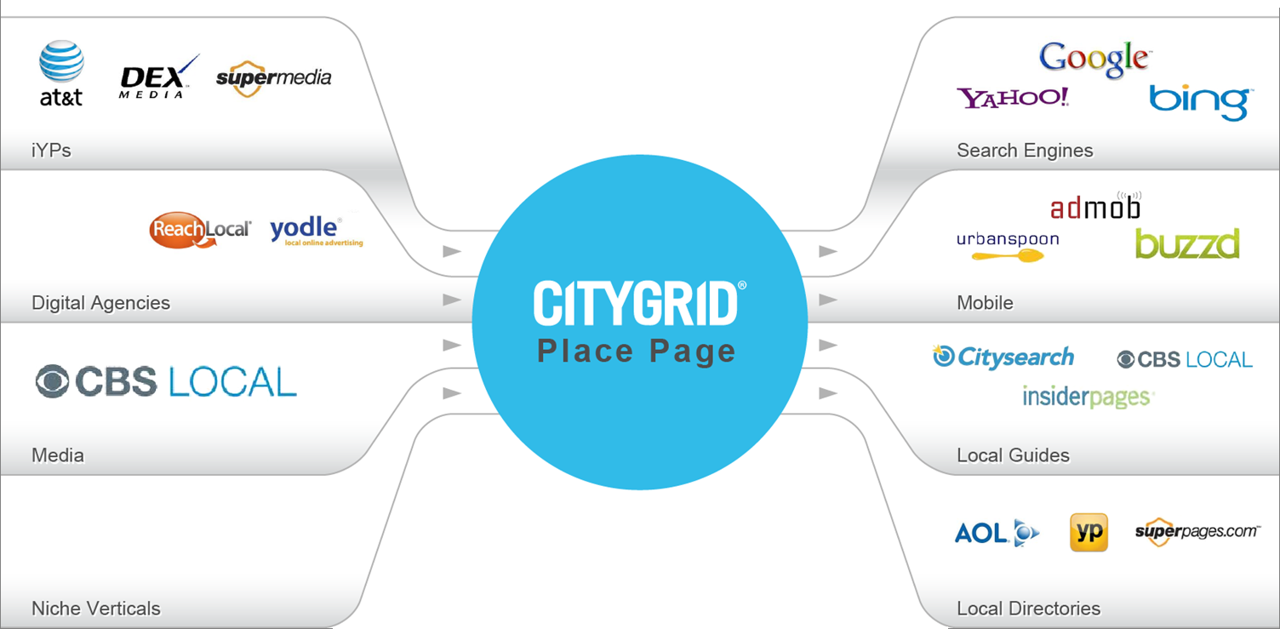


CityGrid
Limos.com

Slide 3
The Challange
Limos.com
17-20 MM Places in US
30+ MM Content
300 MM Places Worldwide
2010: 100+ MM calls/day
2011: 200+ MM calls/day
2012: 1+ Billion calls/day

Slide 4
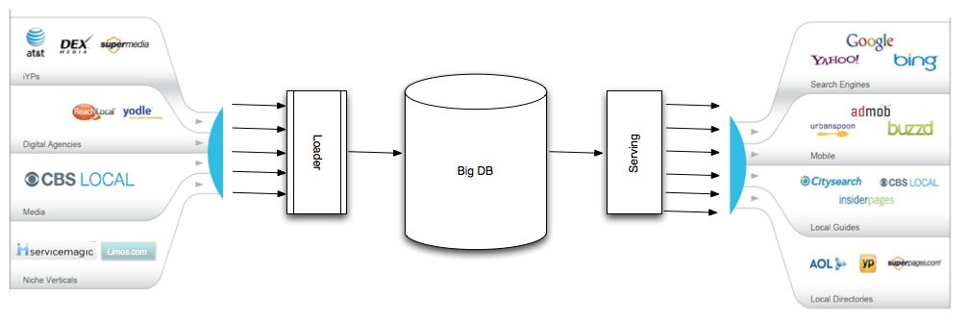
The problem

Slide 5

Big Bottleneck!

Slide 6

Single POF!

Slide 7
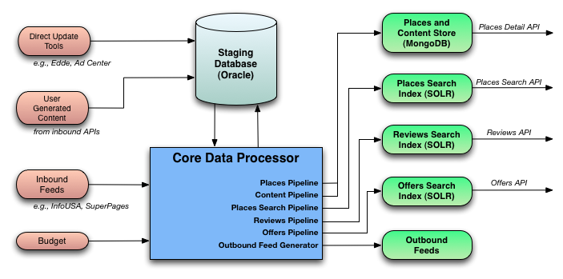
CityGrid Platform Architecture

Slide 8

Places Processing

Slide 9
Places Processing
CityGrid Place
InfoUSA
Citysearch
Other Source…
Name
Address
Phone
Images
Name
Address
Phone
reviews
Name
Address
Phone
menu

Slide 10

Why is it hard?
Book is to ISBN what Product is to UPC and what Place is to ______
No centrally regulated unique id (tax id is, but not public). Now what?
Spago
176 Canon Dr Beverly Hills, CA 90210
310-944-3924
R. French Ac & Heating Inc | Ray French Air Conditioning & Heating Service
2211 martin luther king blvd los angeles, CA, 90069 | 2211 MLK boulevard #104 west Hollywood, CA, 90069
310-358-5903 | 866-465-5303

Slide 11
Problem Definition
Medium size data set
  300 mill records per day, 120 cols/each
Time to process
Hybrid environment
Not all data is from same source

Slide 12
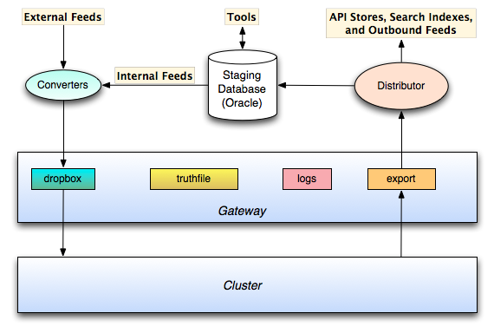
Solution

Slide 13
Normalizer
Soundex
Metaphone
NYSIIS
Matching Rating Approach
Coverphone

Slide 14
Know Your Data
Stop Words
Stemming
The Viper Room Viper Room
av aven avenu
Compression
county line county rd county road
Truncation
apt unit #
avenue avn avnue

Slide 15
Normalizer
123 Martin Luther King.\n
123 MartinLutherKing.
123 martinlutherking.
Martin Luther King | martinlutherking
canon column
the | \n | ave | (tokens)

Slide 16

Matching Strategy
Do what you can on automated fashion and complement with manual steps.
Provided by: Idea go

Slide 17
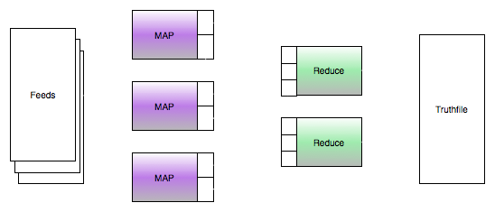
Matching Strategy
Exact matching
Set similarity joins
Custom fuzzy matching

Slide 18
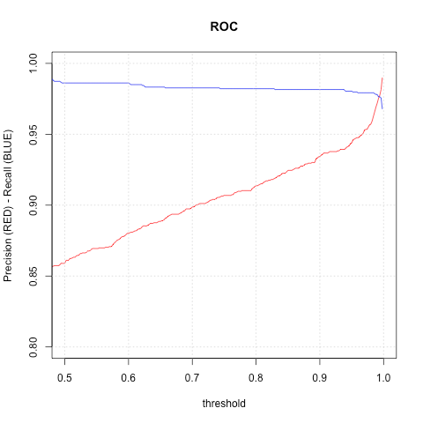
Matching Strategy
C - Support Vector Machine
Threashold: 0.996
  Precision: 98.1%
  Recall: 97.5%

Slide 19
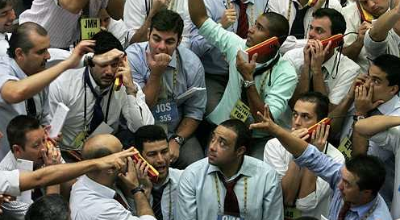
Merger
Rules:
Provider truthworthiness
Voting rules
New data vs Old data
Super providers
History:
Accepted
Rejected

Slide 20
Example
123 M L K Road Ste 45 | 123 Martin Luther King Rd | 123 Martin L King Drive #45
123 m l k road ste 45
123 martin luther king rd
123 martin l king drive #45
(123) (m) (l) (k) (road) (ste) (45)
(123) (martin) (luther) (king) (rd)
(123) (martin) (l) (king) (drive) (#) (45)
123 mlk road ste 45
123 martinlutherking rd
123 martinlking drive # 45
123 mlk rd ste 45
123 mlk rd
123 mlk dr #45
123 mlk rd
123 mlk rd
123 mlk dr
123 mlk
123 mlk
123 mlk
MATCH!
MATCH!
MATCH!

Slide 21


Findings & Tips
Domain Knowledge
Automation
Mechanical Turk
Machine Learning
Run every 2hrs

Slide 22


Slide 23
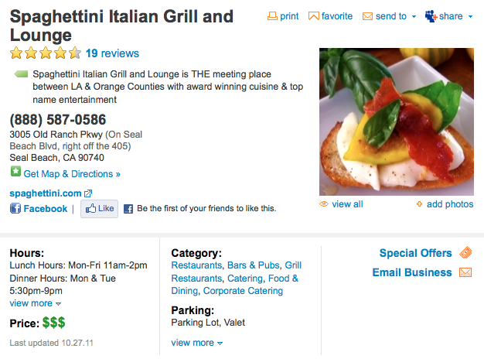
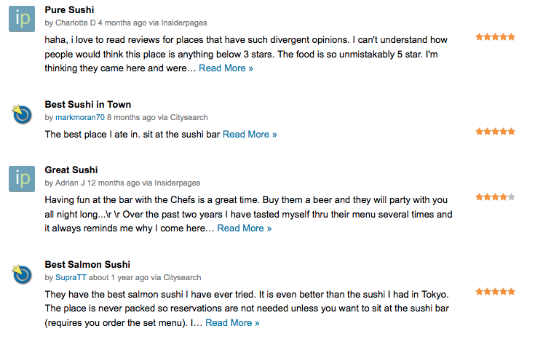

Developer API’s
developer.citygridmedia.com

Slide 24
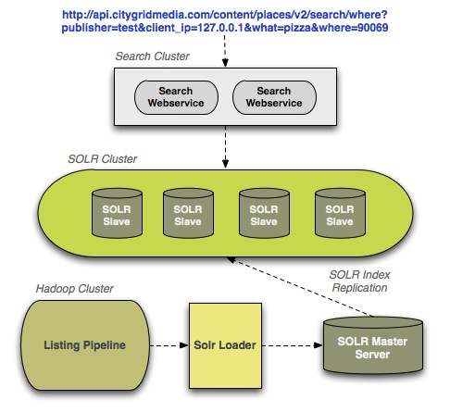
Solution for Search APIs

Slide 25



Requirements for Places Store
Scalability
Built in Partitioning & Replication
No Schema
De-normalized Fast Document Reads
Good Documentation / Support
Mongo DB satisfied all our requirements!!

Slide 26
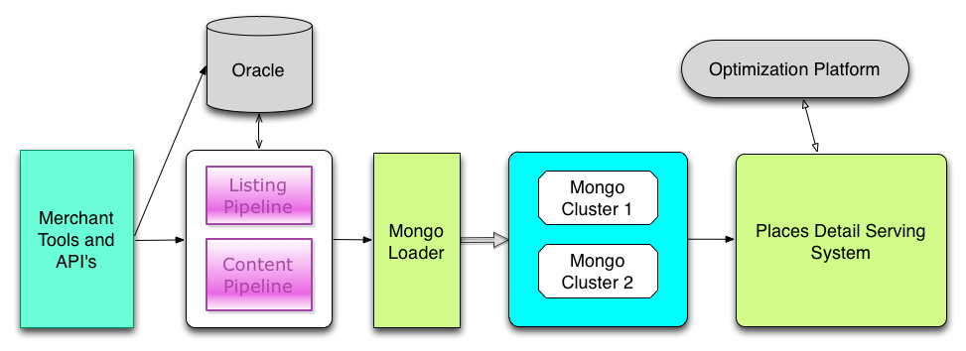
Solution for Places API

Slide 27
The Listing Collection
PRIMARY> db.listing.findOne({"public_id":"pinks-los-angeles"})
{
"_id" : ObjectId("4f0c0e974e8ab89b6982d39e"),
"public_id" : "pinks-los-angeles",
"phone" : "2133878525",
"cs_rating" : "8",
"business_operation_status" : "1",
"id_alternates" : ["cg:45457592”,"iusa:615760956”],
"address" : {
"street" : "326 S Western Ave",
"city" : "Los Angeles",
"postal_code" : "90020",
"cross_street" : "",
"latitude" : 34.0684,
"longitude" : -118.3089,
"state" : "CA”},
"name" : "Pink's”
}

Slide 28
The Content Collection
PRIMARY> db.content.findOne({public_id:” pi-on-sunset-los-angeles",cap_provider_id:{$in:[”0”,”1”]}})
{
"_id" : "pi-on-sunset-los-angeles_0_70507571_image",
"width" : "216",
"public_id" : "pi-on-sunset-los-angeles",
"url" : "http://images.citysearch.net/assets/imgdb/auth_ws/2010/4/20/0/ZtOIaiiG0.jpeg", "attribution_text" : "Citysearch",
"content_id" : "70507571",
"height" : "216",
"attribution_logo_path" : "http://images.citysearch.net/assets/imgdb/custom/ue-357/CS_logo88x31.jpg",
"content_provider_name" : "CITYSEARCH",
"image_type" : "generic_image",
"listing_id" : "45228161",
"content_type" : "image",
"content_provider_id" : "5",
"cap_provider_id" : "0"
}

Slide 29
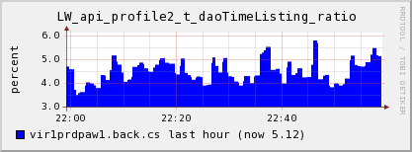
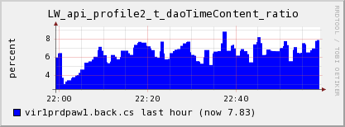
Performance Results

Slide 30

Updates
Hours
Real Time

Slide 31
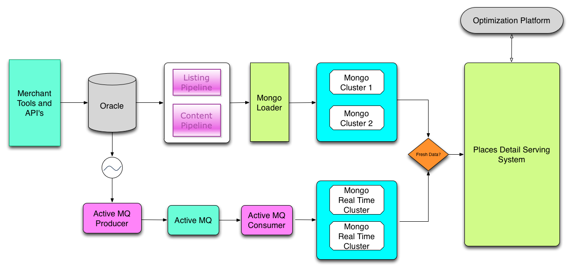
Real Time Updates

Slide 32

It’s Demo Time!
Notes:
Demo

Slide 33

Improvements
Shard Listing and Content Data
Integrate Mongo across all APIs

Slide 34

APIs
Now we have rich Places API
How do we make developers aware they exist?
How do we get them to successfully integrate?

Slide 35

APIs – Supporting Developer Area
Common Building Blocks
Getting Started
Publisher Overview
Documentation
FAQ
Terms of Use
Terms of Use

Slide 36

APIs – Supporting Developer Area
Developers Tools
Code Samples
Libraries
Mobile SDKs
Starter Kits
Hackathon Toolkits
Partner APIs
Terms of Use

Slide 37



APIs – Evangelism - Online
Blogging
Twitter
LinkedIn
Facebook
Github
Stack Overflow
Quora
Hacker News
StumbleUpon
Reddit
Terms of Use

Slide 38
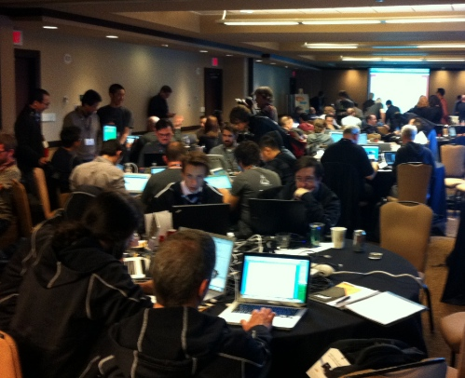
APIs – Evangelism - Offline
Conferences
Hackathons
Meetups
Workshops
Terms of Use

Slide 39
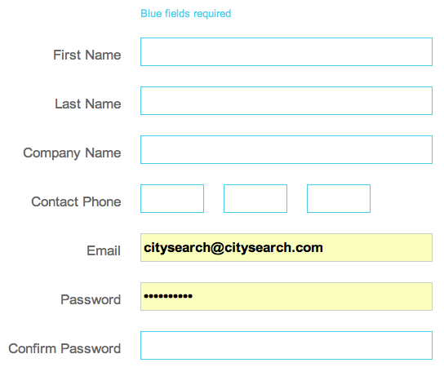
APIs – Easy Start + Engage Immediately
Testable APIs
Self-Service
Email After Registration
Follow on Twitter
Follow on LinkedIn
Terms of Use

Slide 40
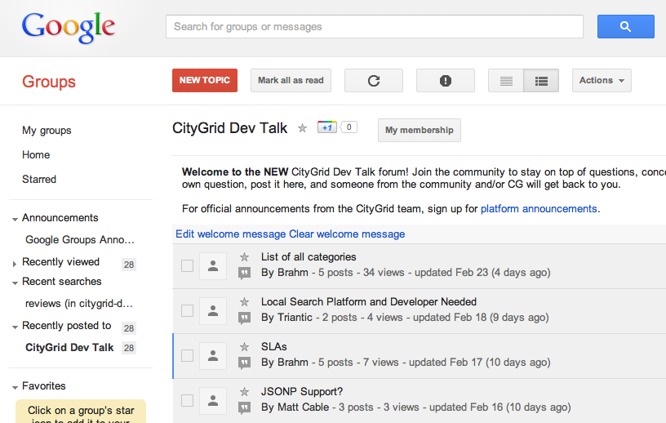
APIs – Feedback Loop + Voice
Email Support
Forum(s)
Twitter
LinkedIn
Terms of Use

Slide 41

APIs – Monetization = Sustainability
Local Web Advertising
Local Mobile Advertising
Local Custom Ads
Places that Pay
Terms of Use

Slide 42

APIs – Evangelize Internally
Developer Feedback
Roadmap Suggestions
Landscape Analysis
Technology Awareness
Trends
Internal Hackathons
Terms of Use

Slide 43

APIs – Measure & Repeat
Terms of Use

Slide 44
Q&A
Thanks to the Team!

Slide 45
Q&A
developer.citygridmedia.com
We are hiring!
citygridmedia.com/careers

